Slide 1
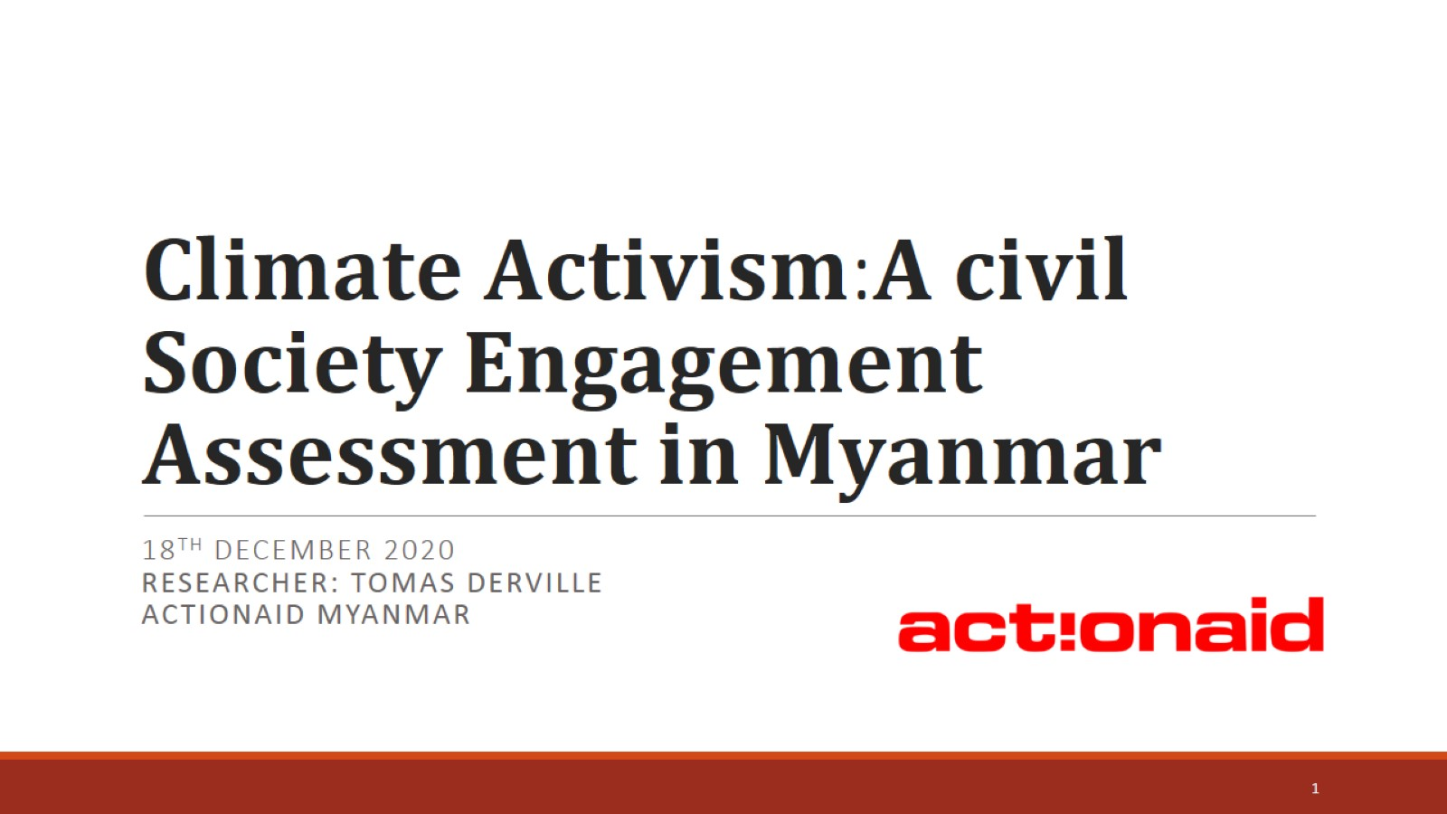
𝐂𝐥𝐢𝐦𝐚𝐭𝐞 𝐀𝐜𝐭𝐢𝐯𝐢𝐬𝐦:𝐀 𝐜𝐢𝐯𝐢𝐥 𝐒𝐨𝐜𝐢𝐞𝐭𝐲 𝐄𝐧𝐠𝐚𝐠𝐞𝐦𝐞𝐧𝐭 𝐀𝐬𝐬𝐞𝐬𝐬𝐦𝐞𝐧𝐭 𝐢𝐧 𝐌𝐲𝐚𝐧𝐦𝐚𝐫

Slide 2
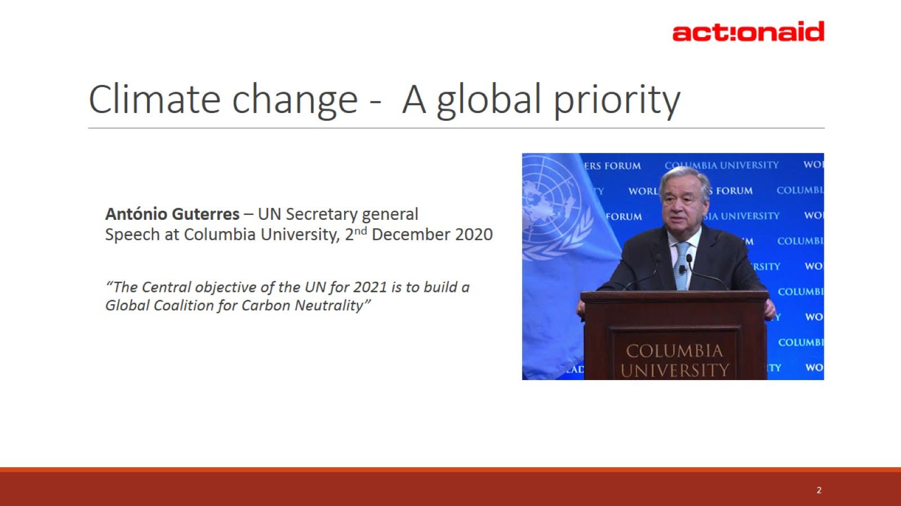
Climate change - A global priority

Slide 3
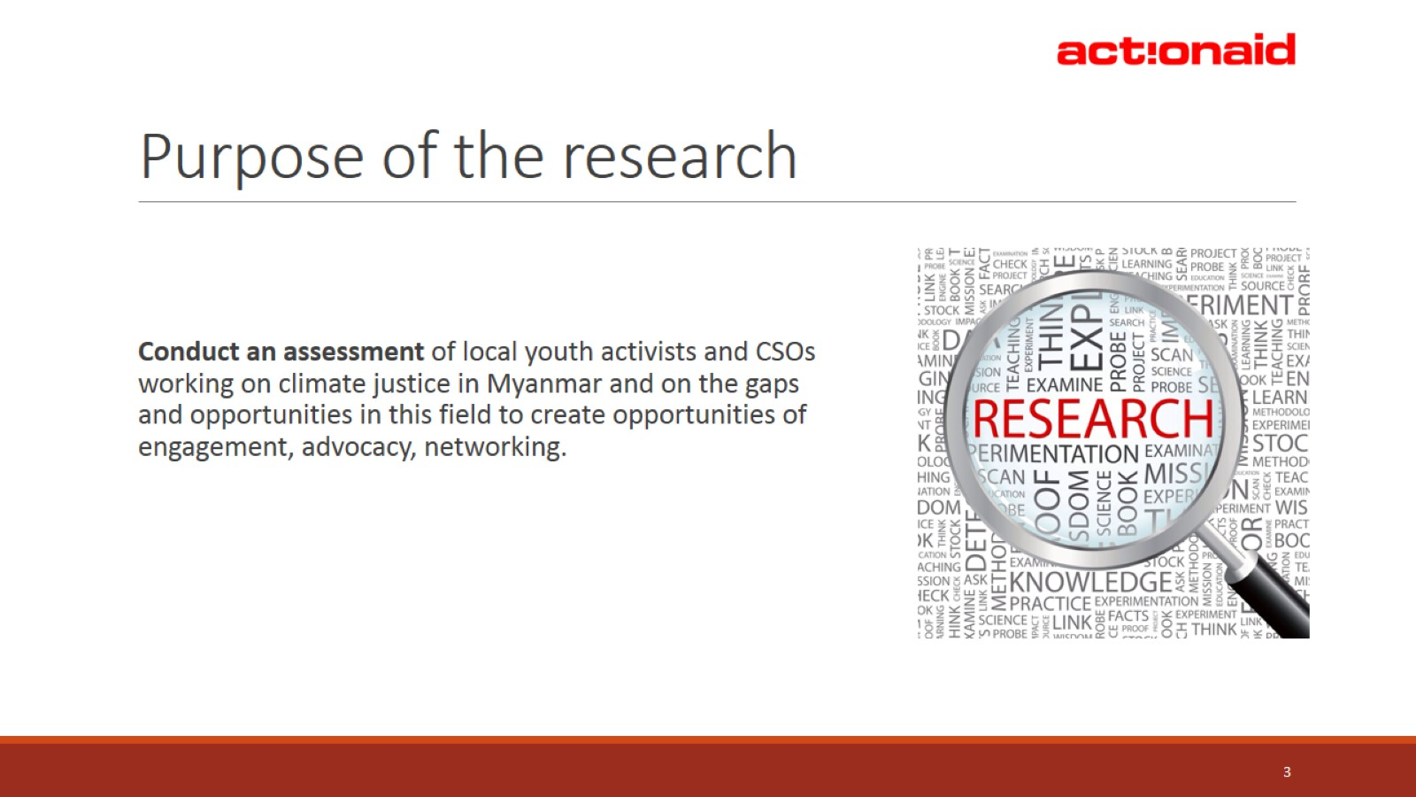
Purpose of the research

Slide 4
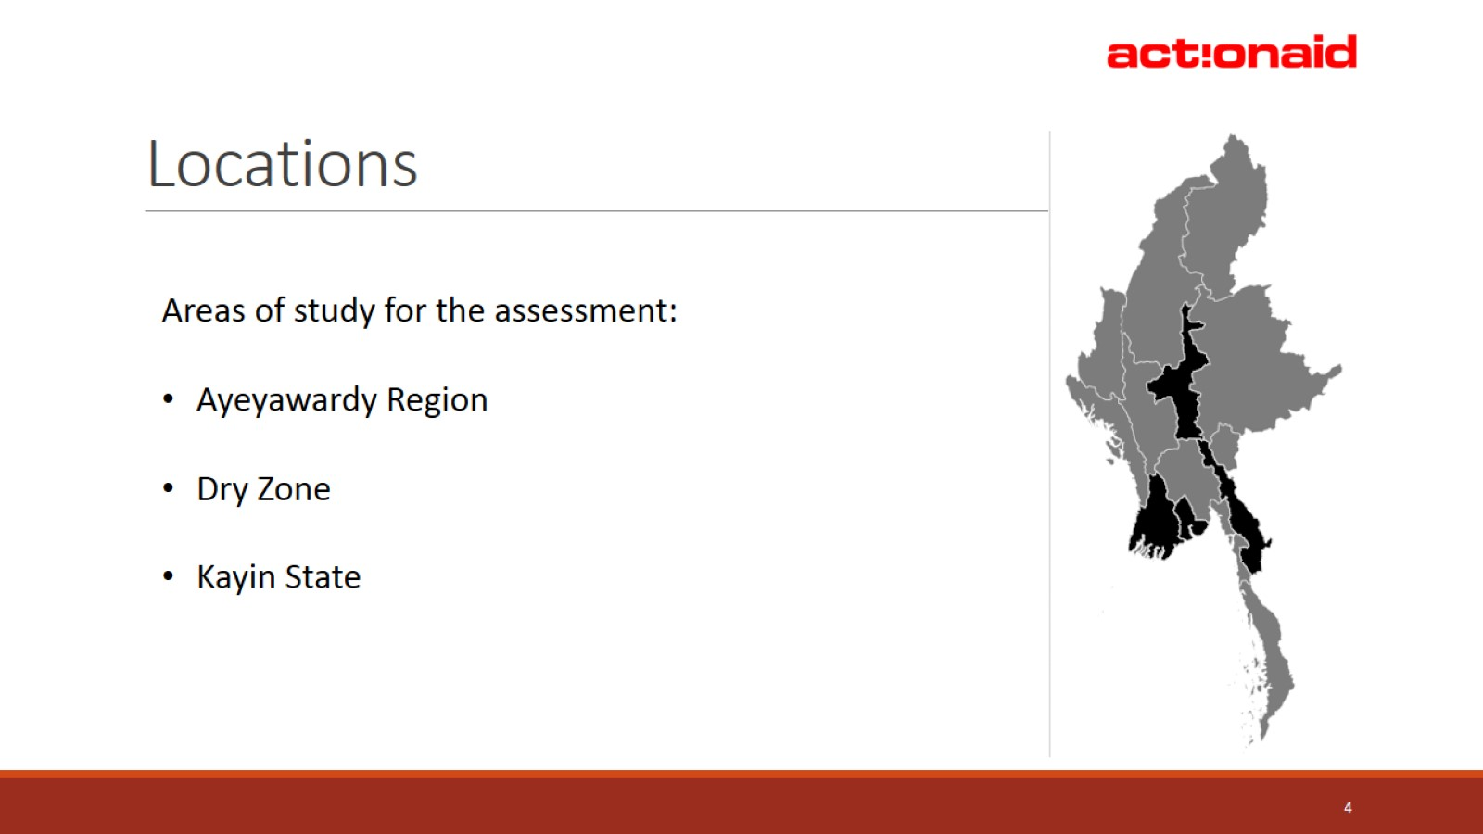
Locations

Slide 5
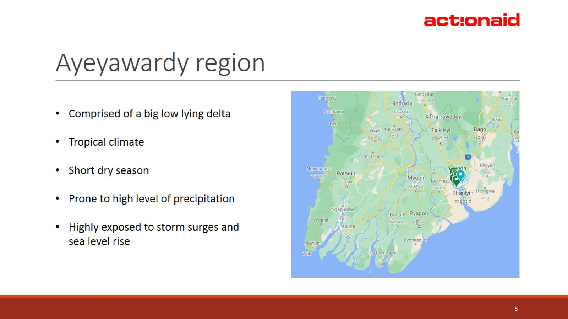
Ayeyawardy region

Slide 6
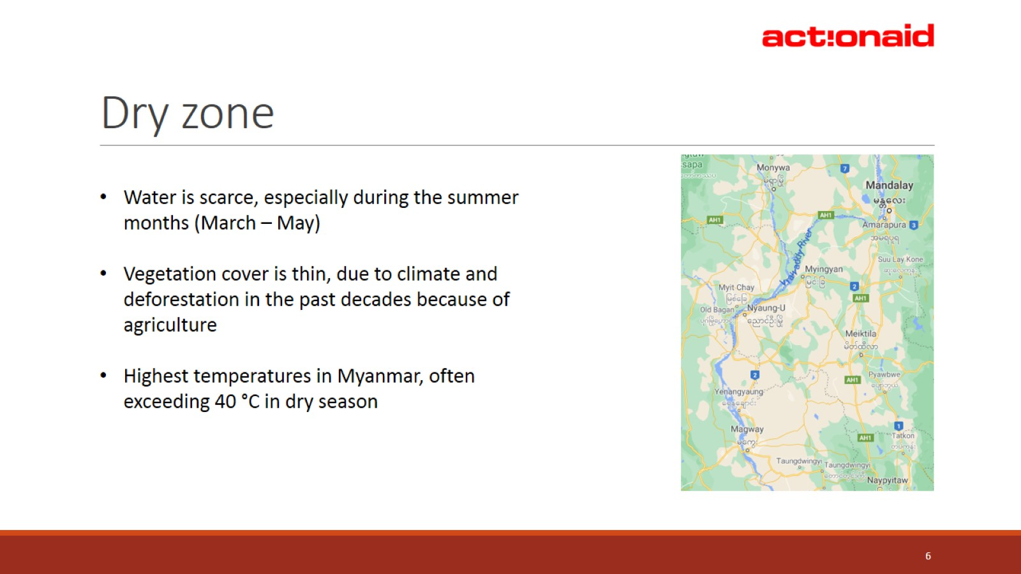
Dry zone

Slide 7
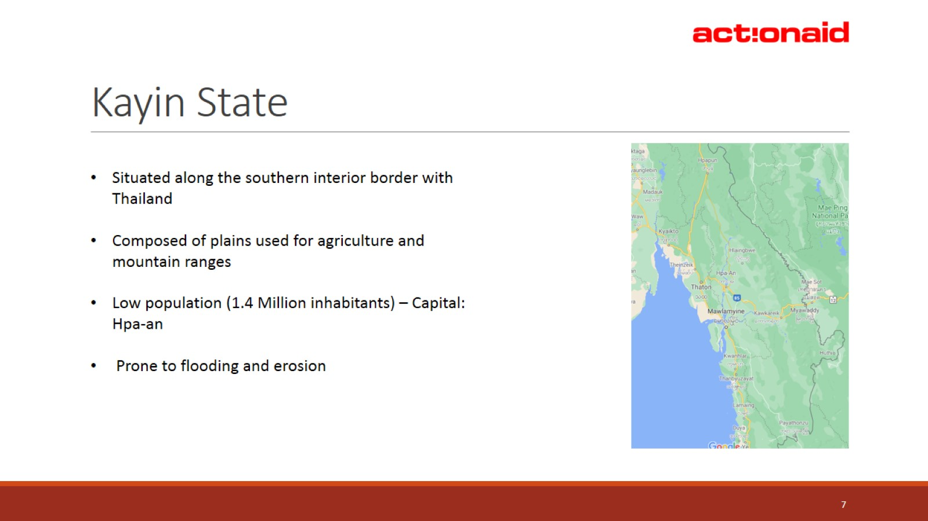
Kayin State

Slide 8
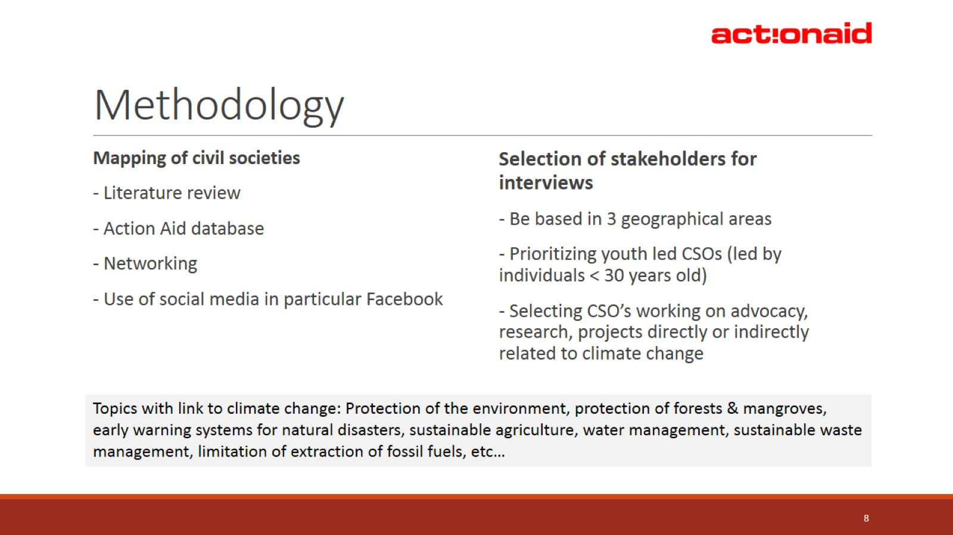
Methodology

Slide 9
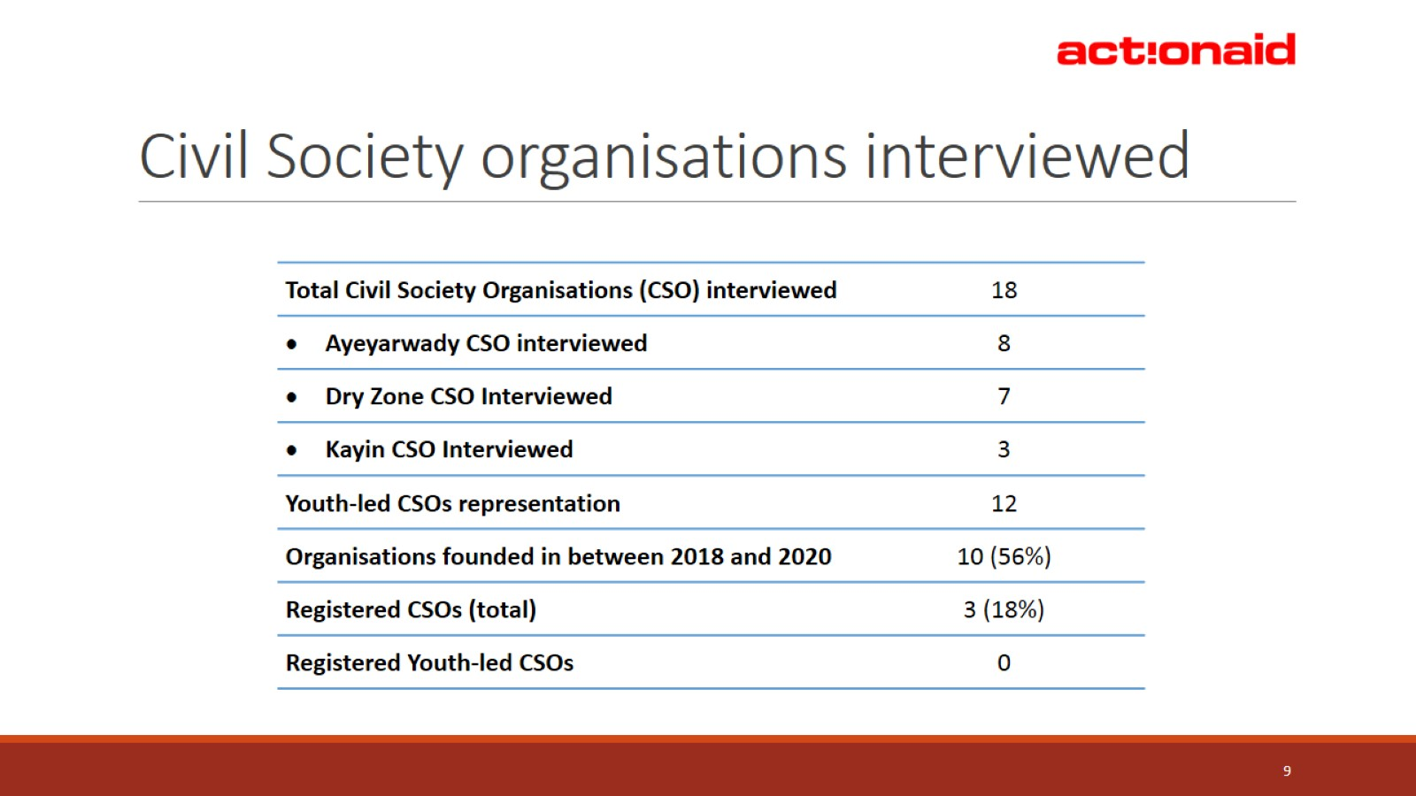
Civil Society organisations interviewed

Slide 10
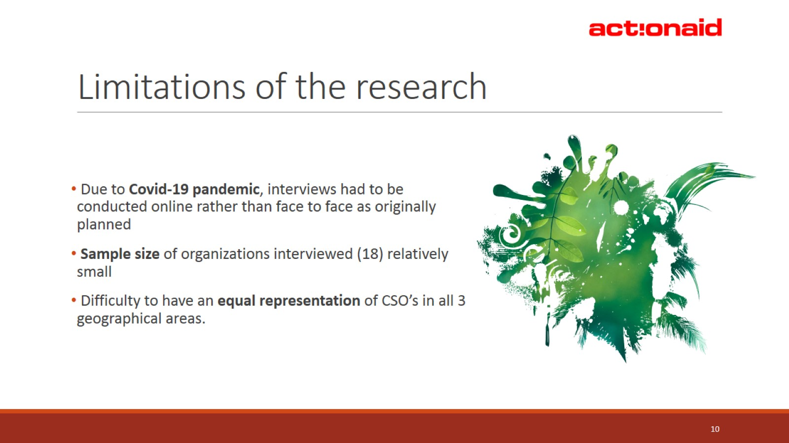
Limitations of the research

Slide 11
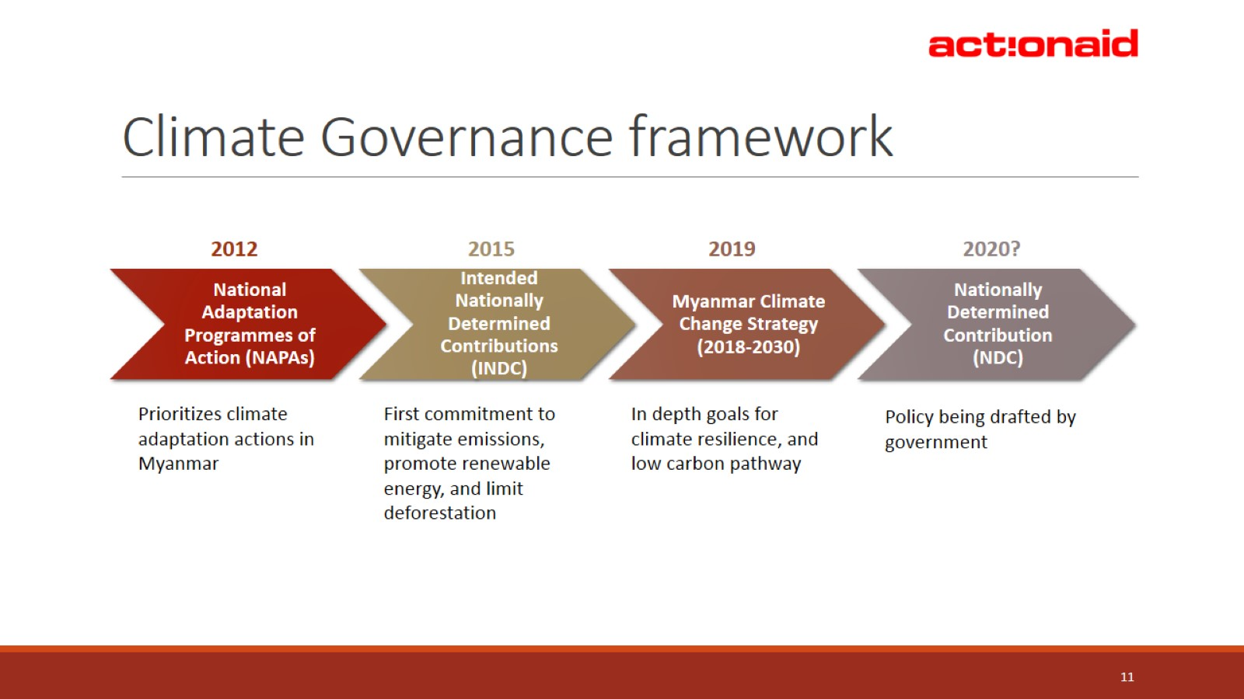
Climate Governance framework

Slide 12
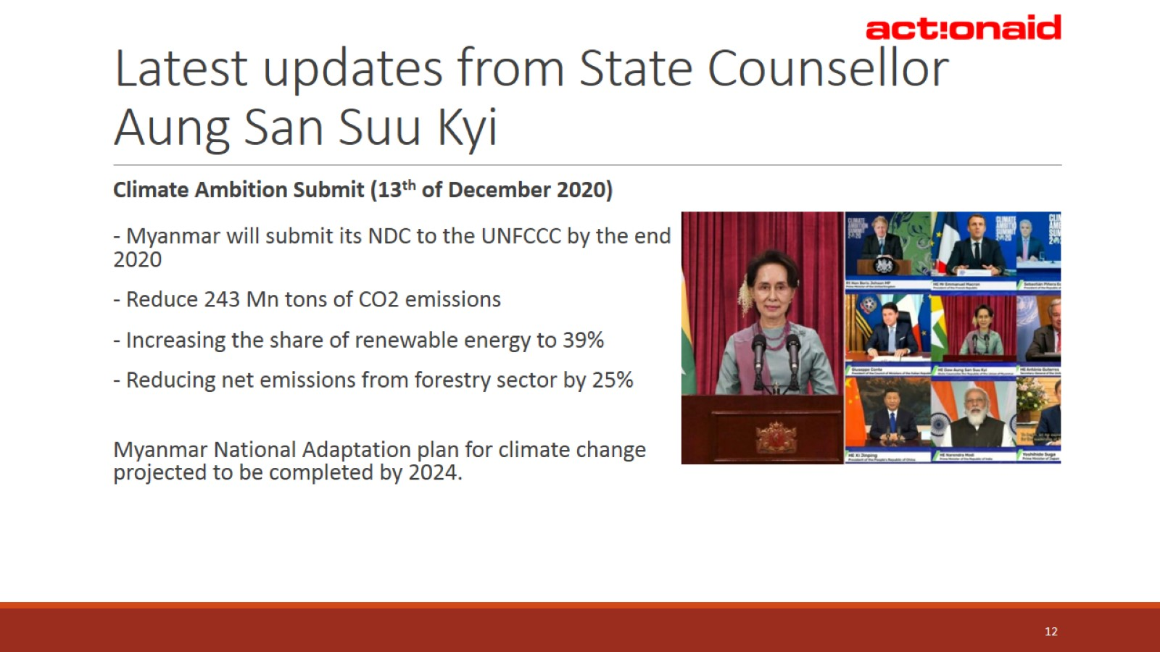
Latest updates from State Counsellor Aung San Suu Kyi

Slide 13
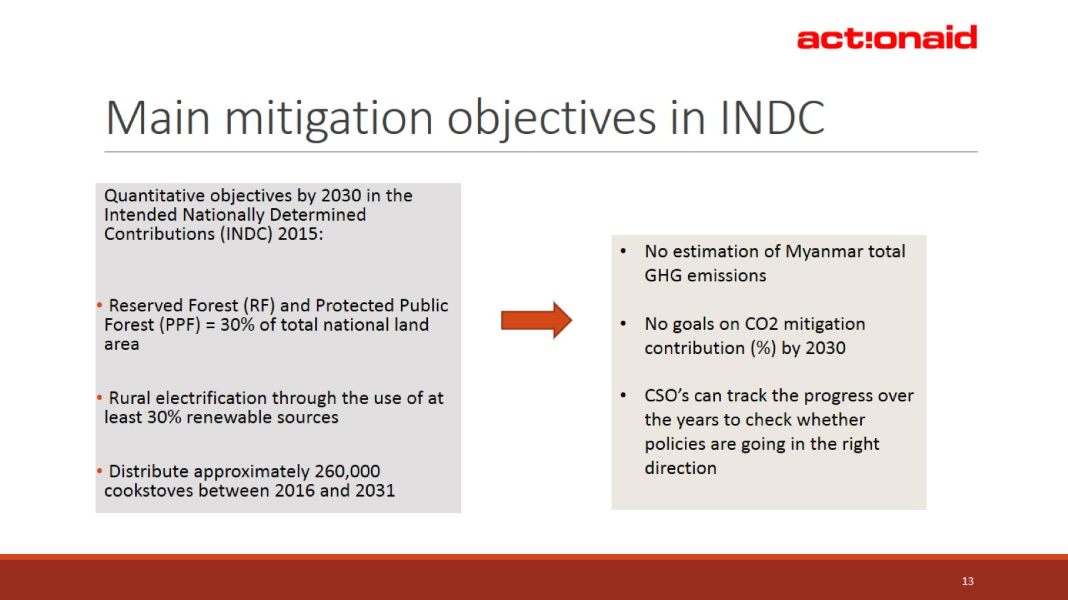
Main mitigation objectives in INDC

Slide 14
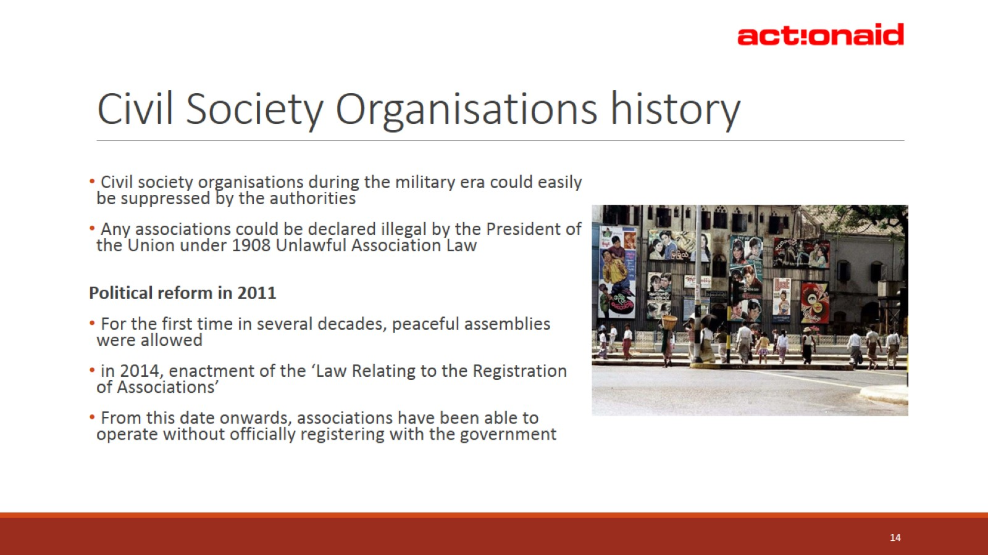
Civil Society Organisations history

Slide 15
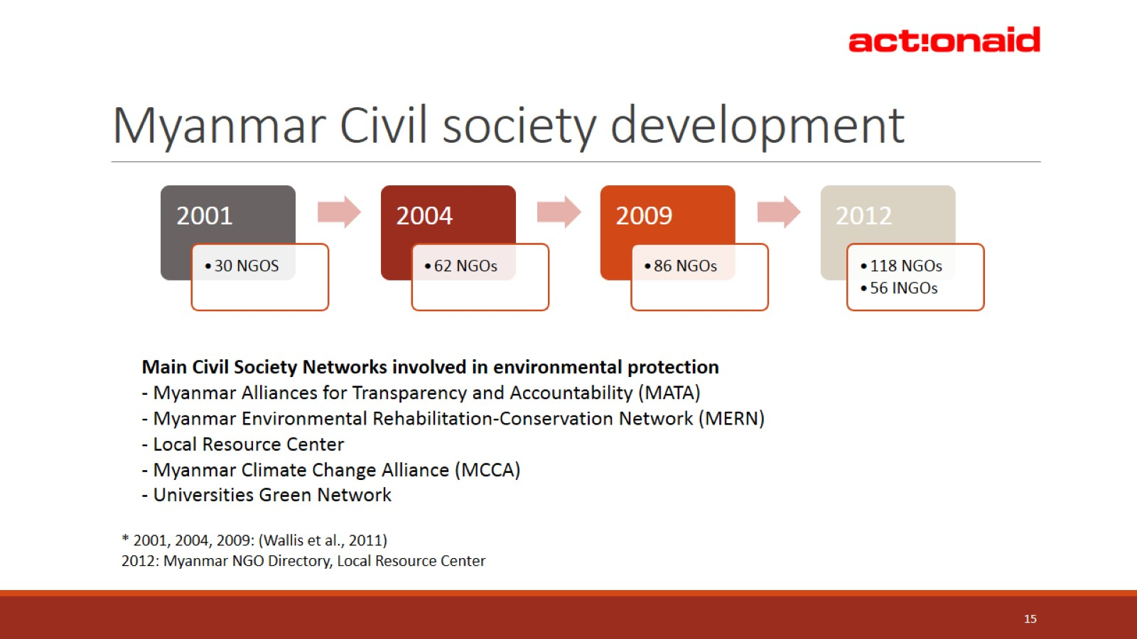
Myanmar Civil society development

Slide 16
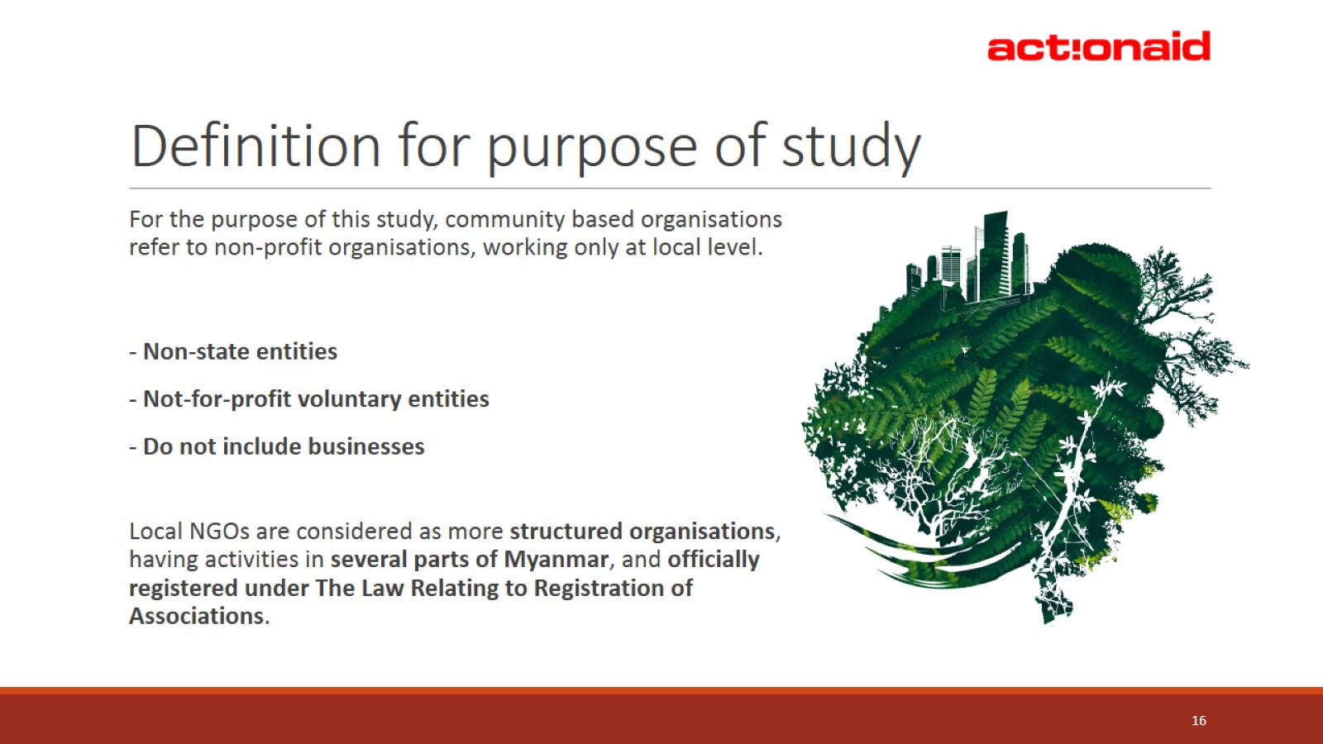
Definition for purpose of study

Slide 17
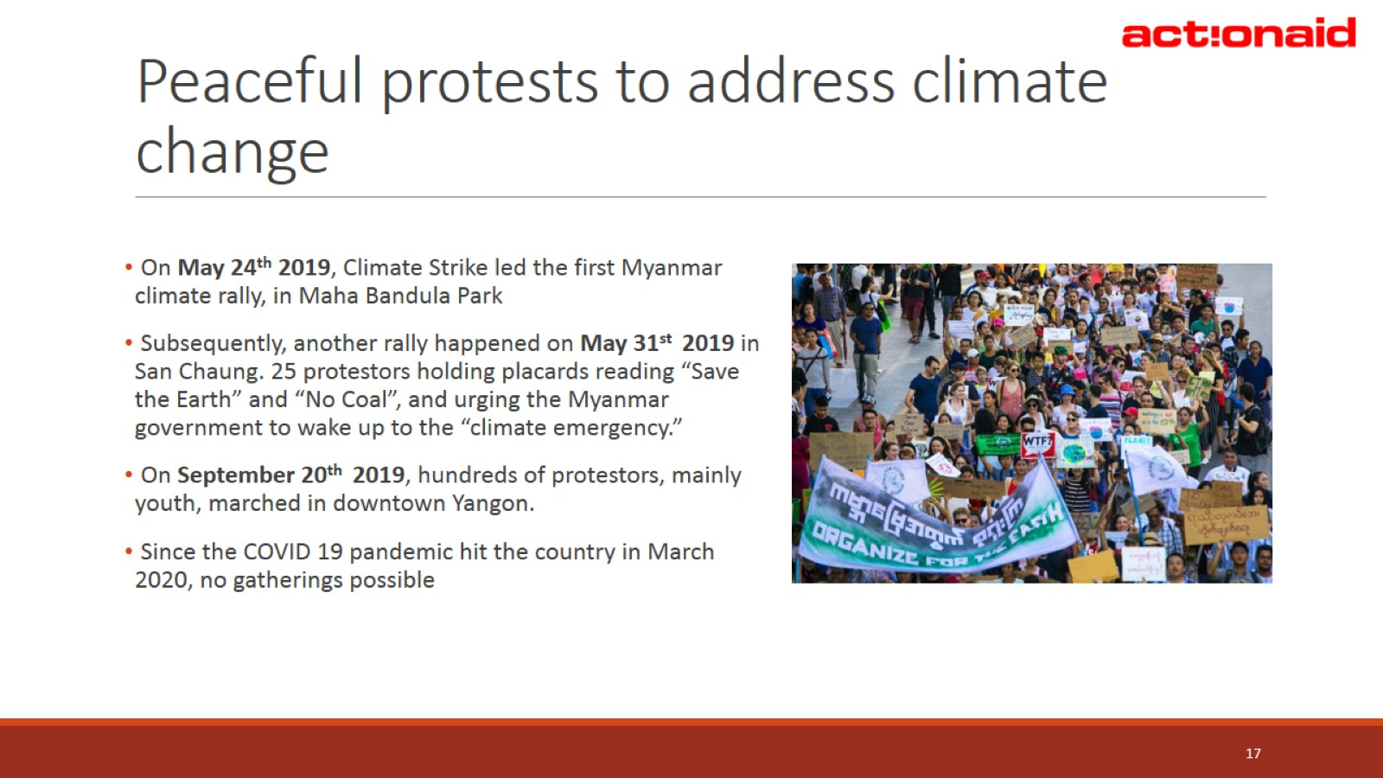
Peaceful protests to address climate change

Slide 18
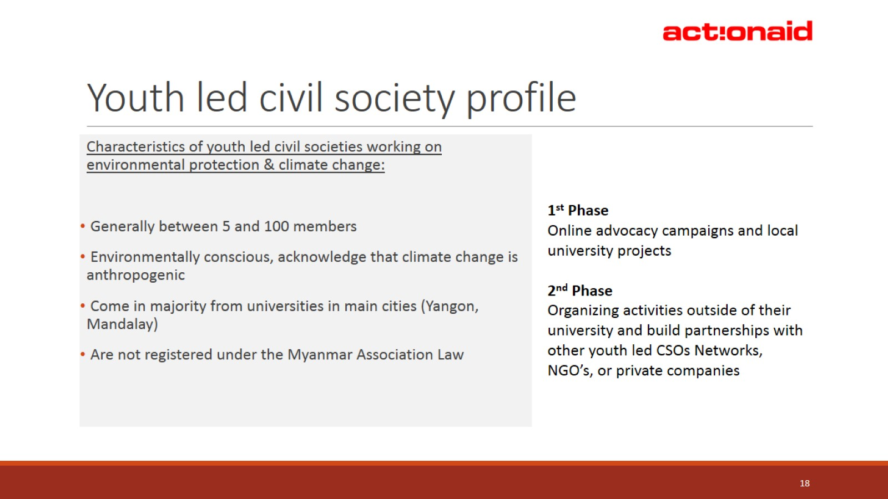
Youth led civil society profile

Slide 19
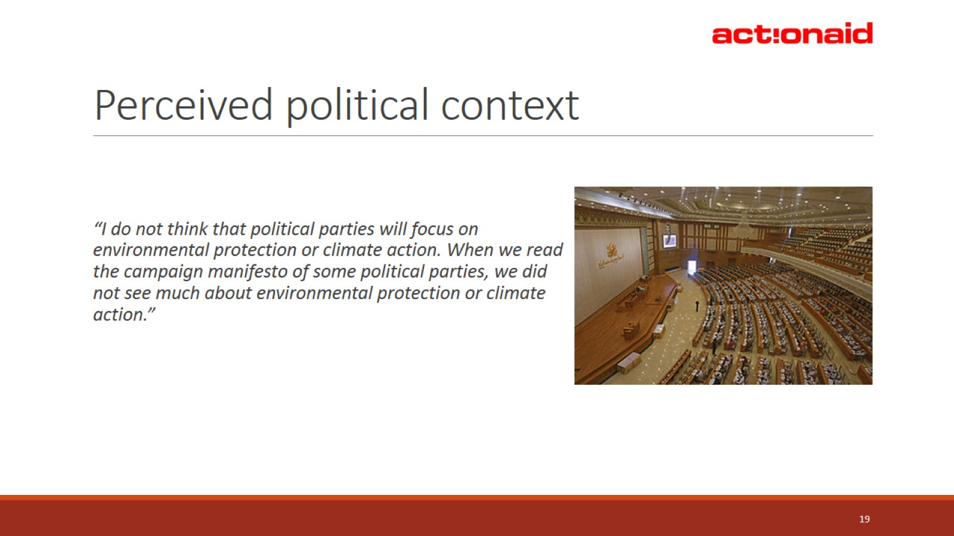
Perceived political context

Slide 20
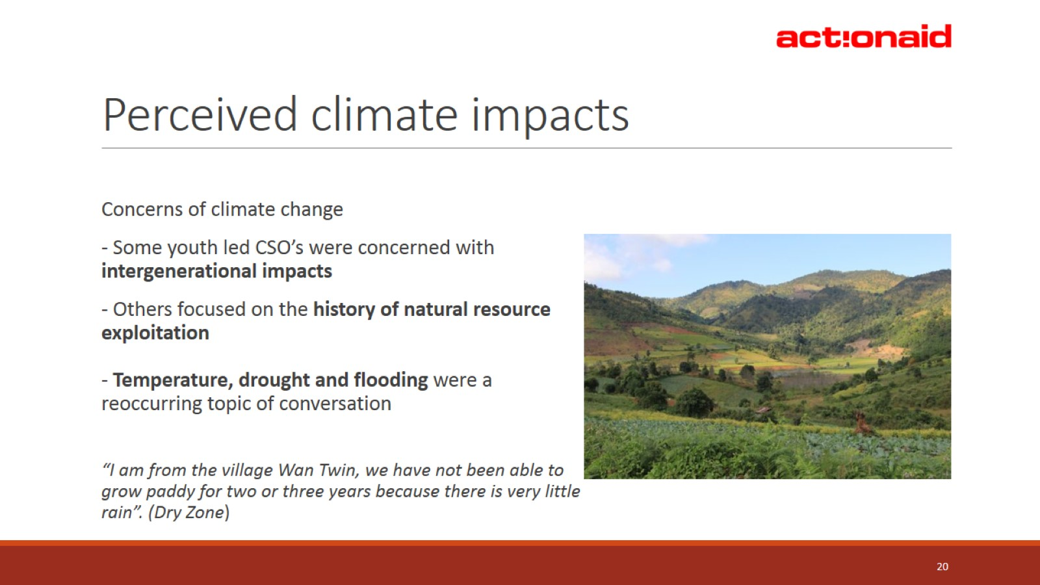
Perceived climate impacts

Slide 21
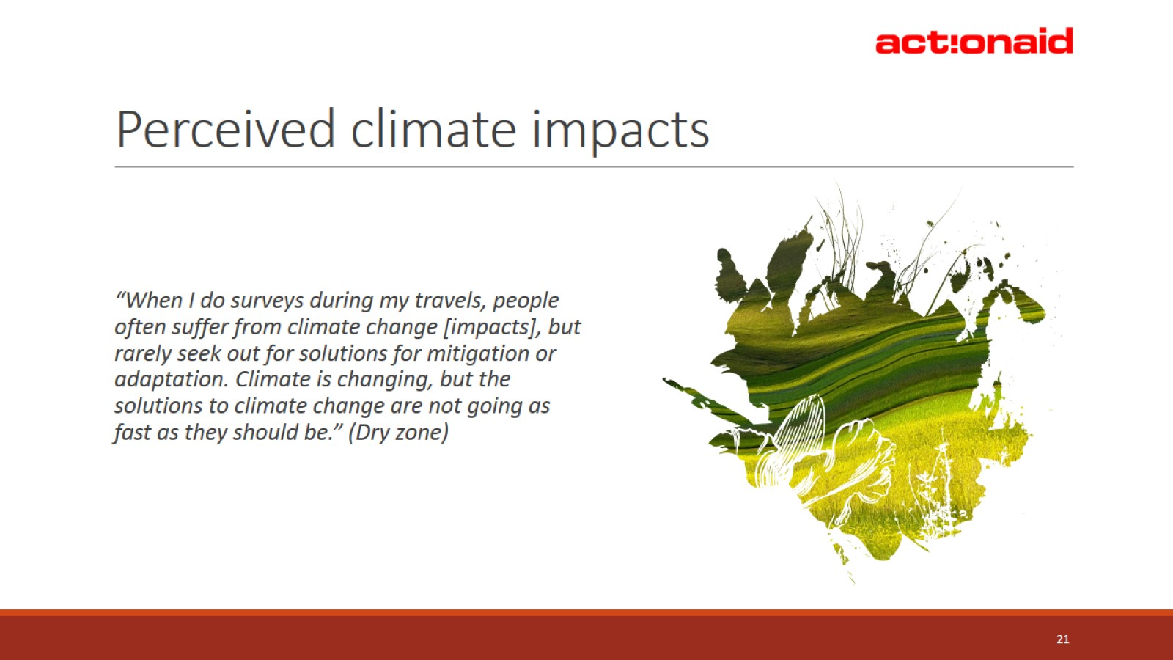
Perceived climate impacts

Slide 22
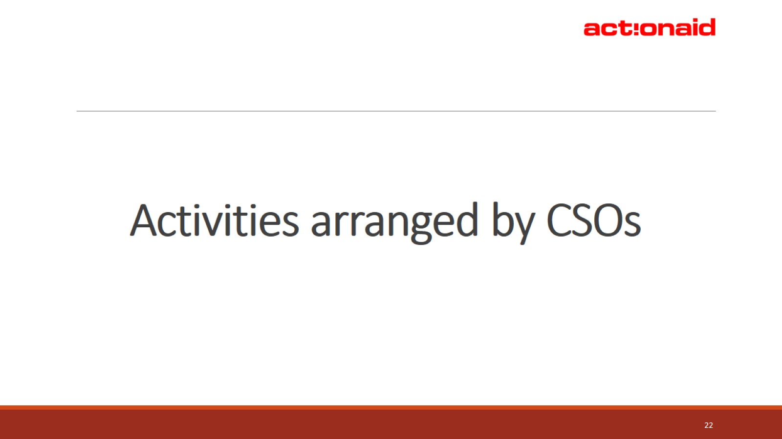
Activities arranged by CSOs

Slide 23
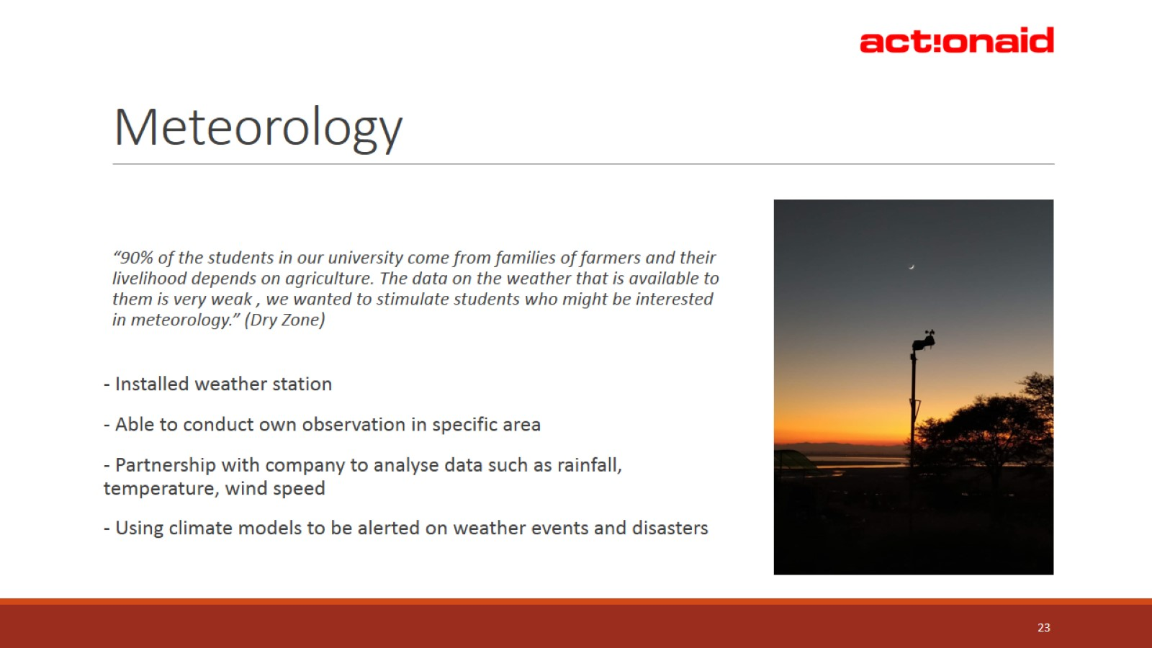
Meteorology

Slide 24
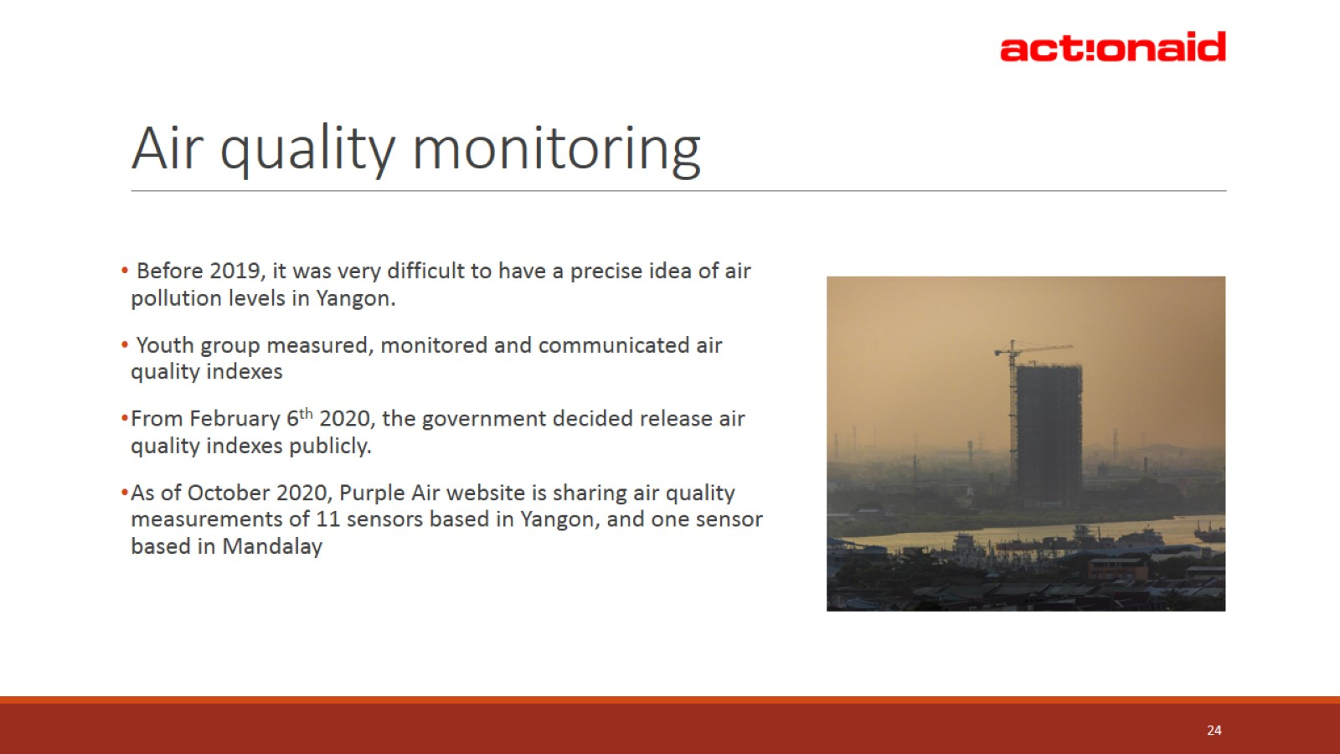
Air quality monitoring

Slide 25
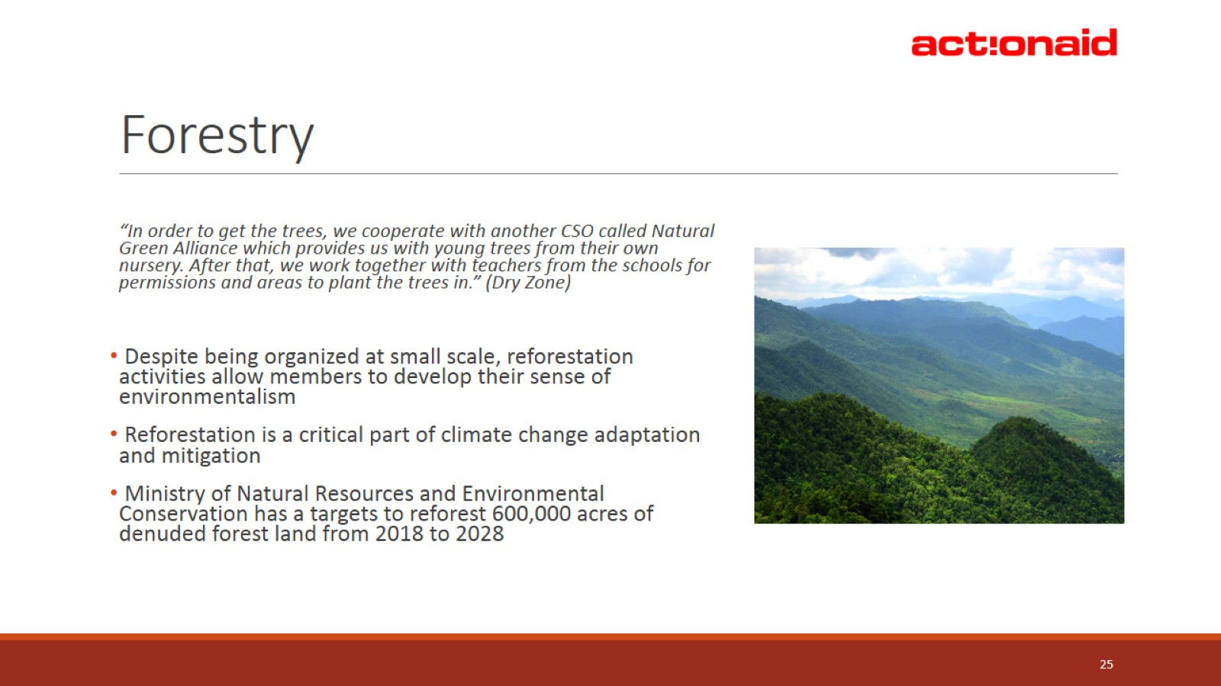
Forestry

Slide 26
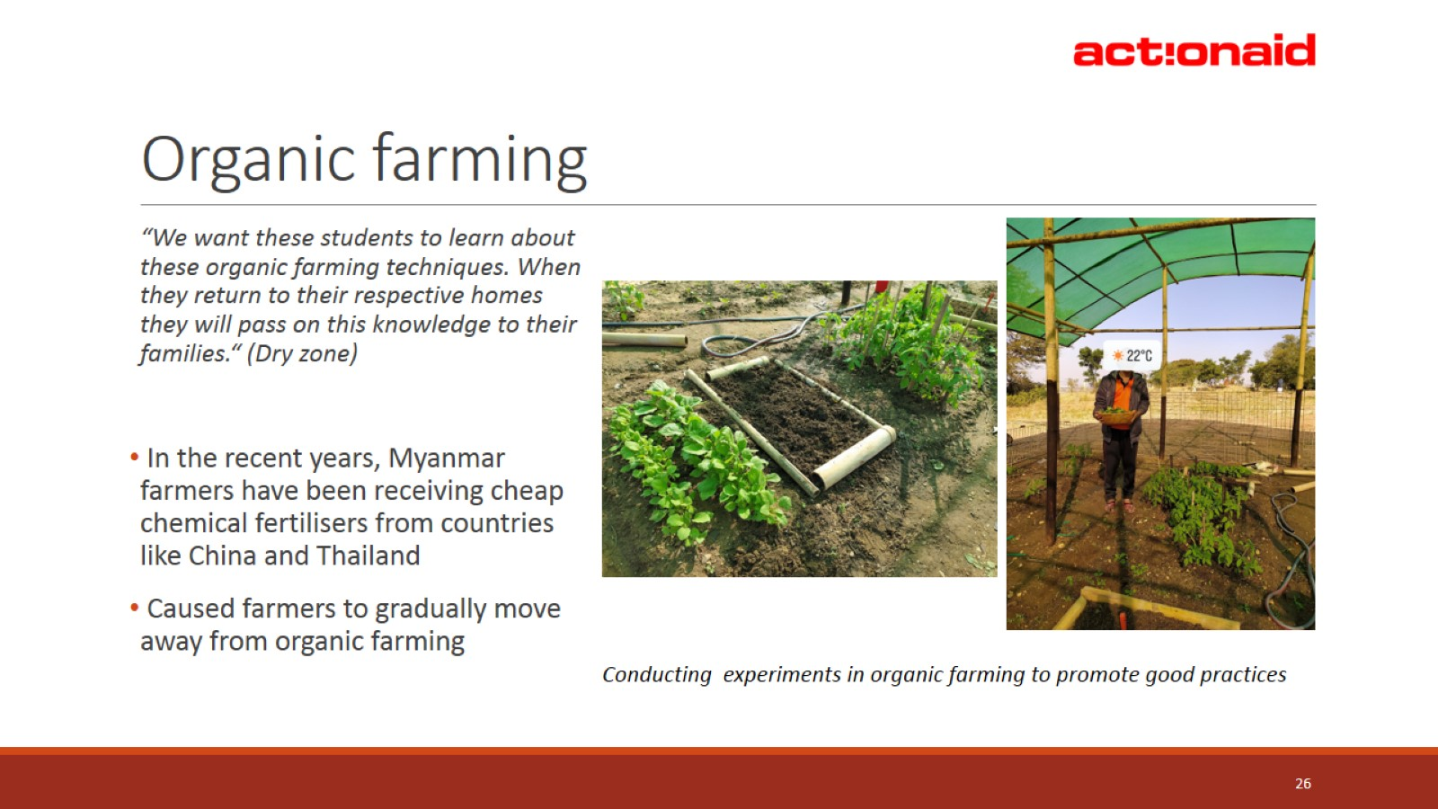
Organic farming

Slide 27
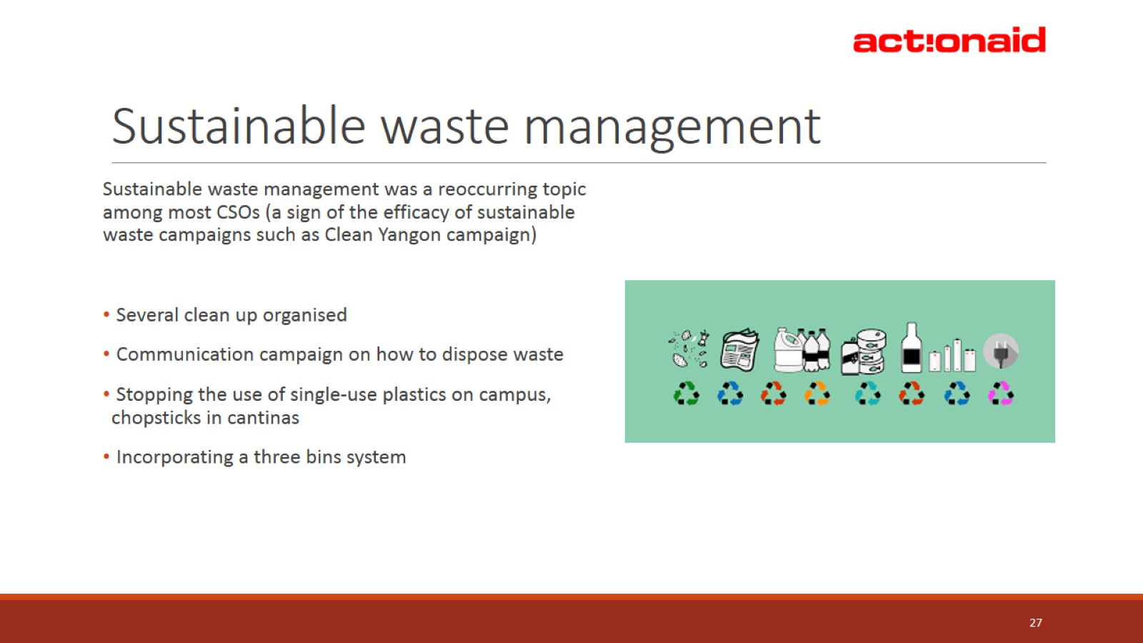
Sustainable waste management

Slide 28
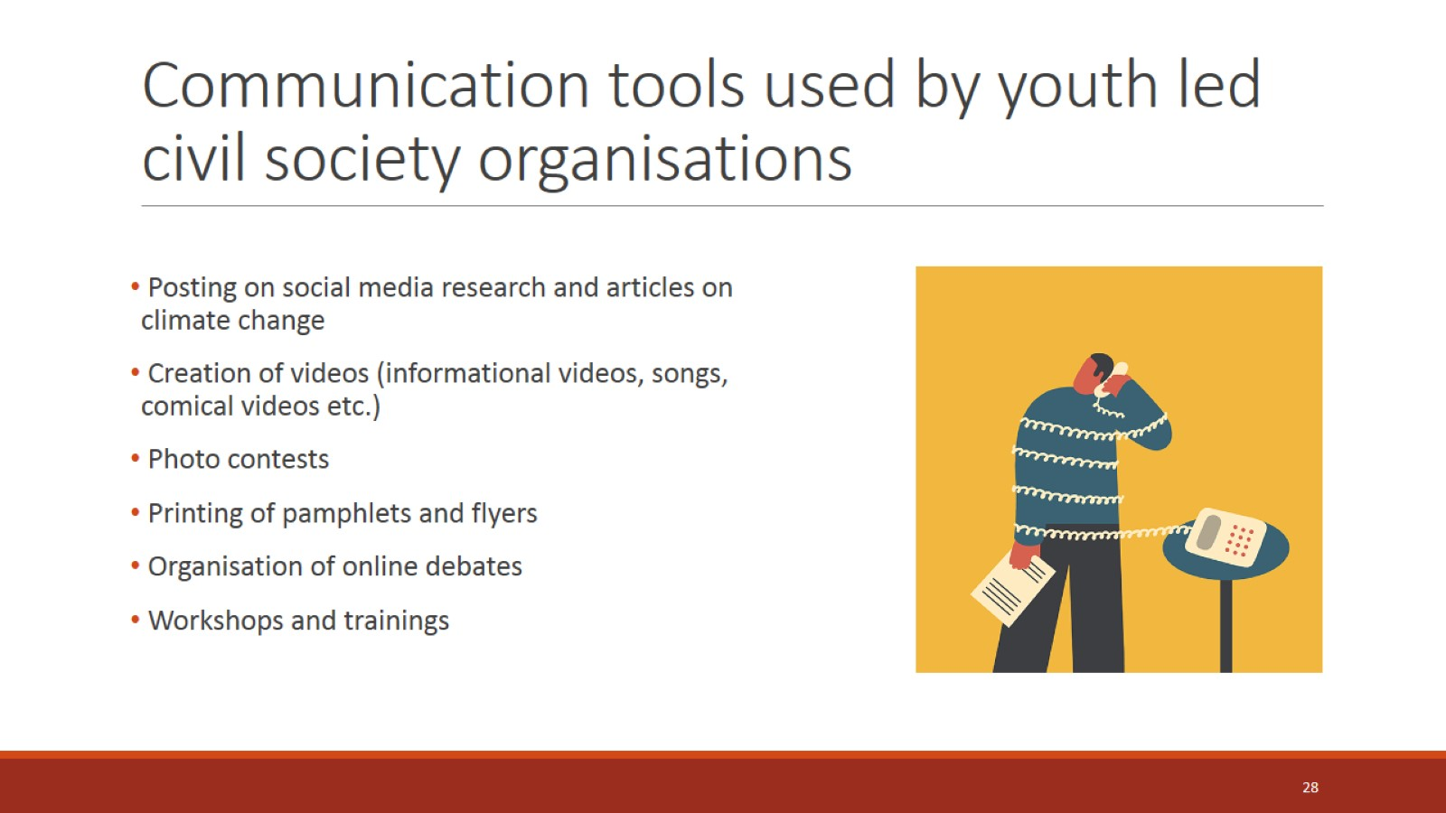
Communication tools used by youth led civil society organisations

Slide 29
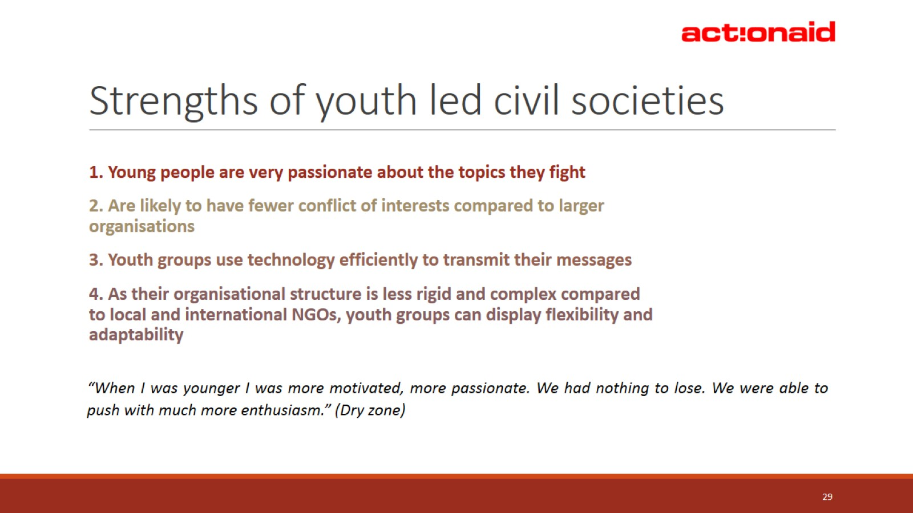
Strengths of youth led civil societies

Slide 30
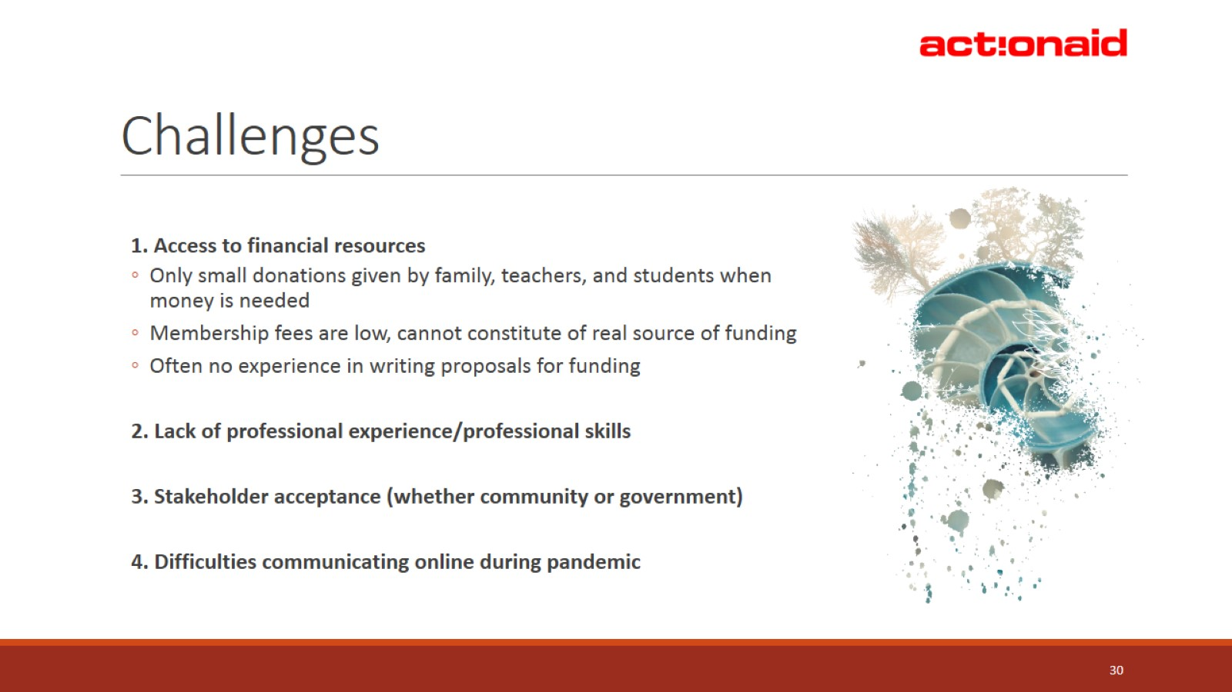
Challenges

Slide 31
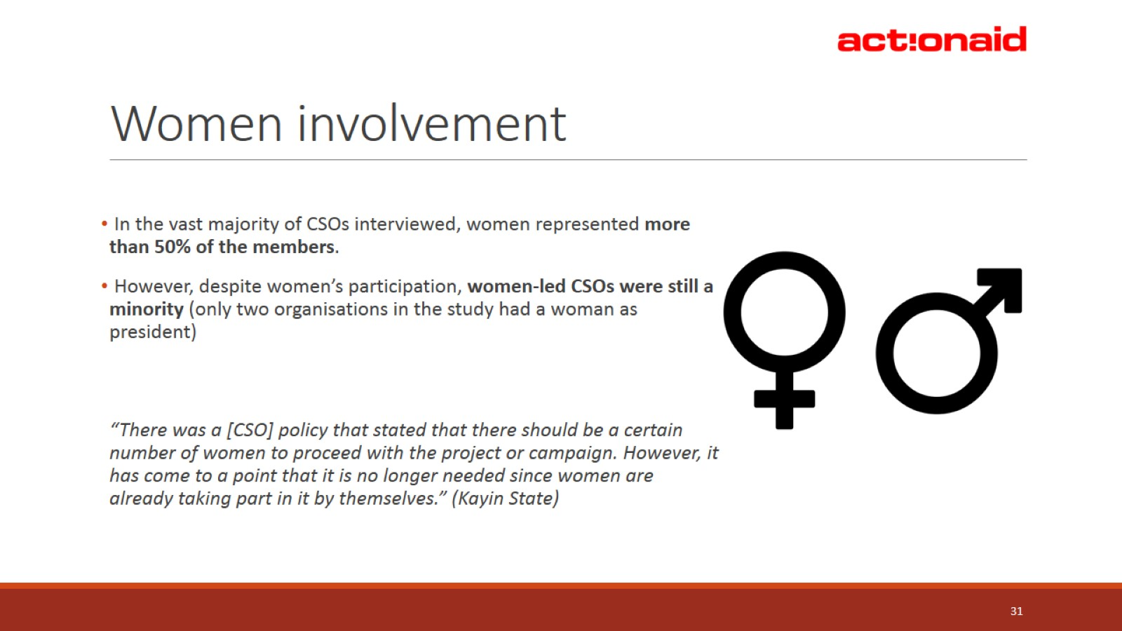
Women involvement

Slide 32
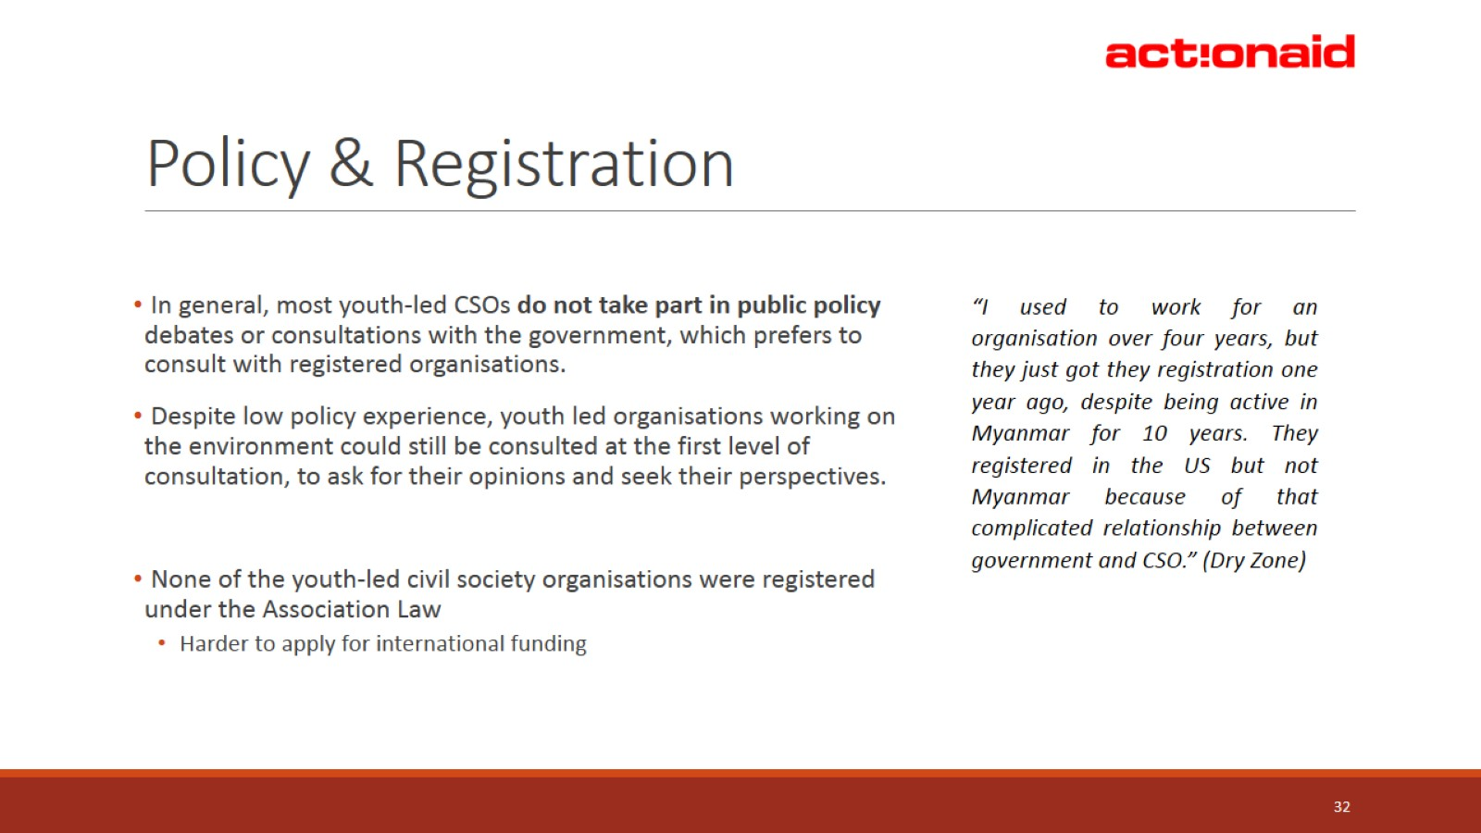
Policy & Registration

Slide 33
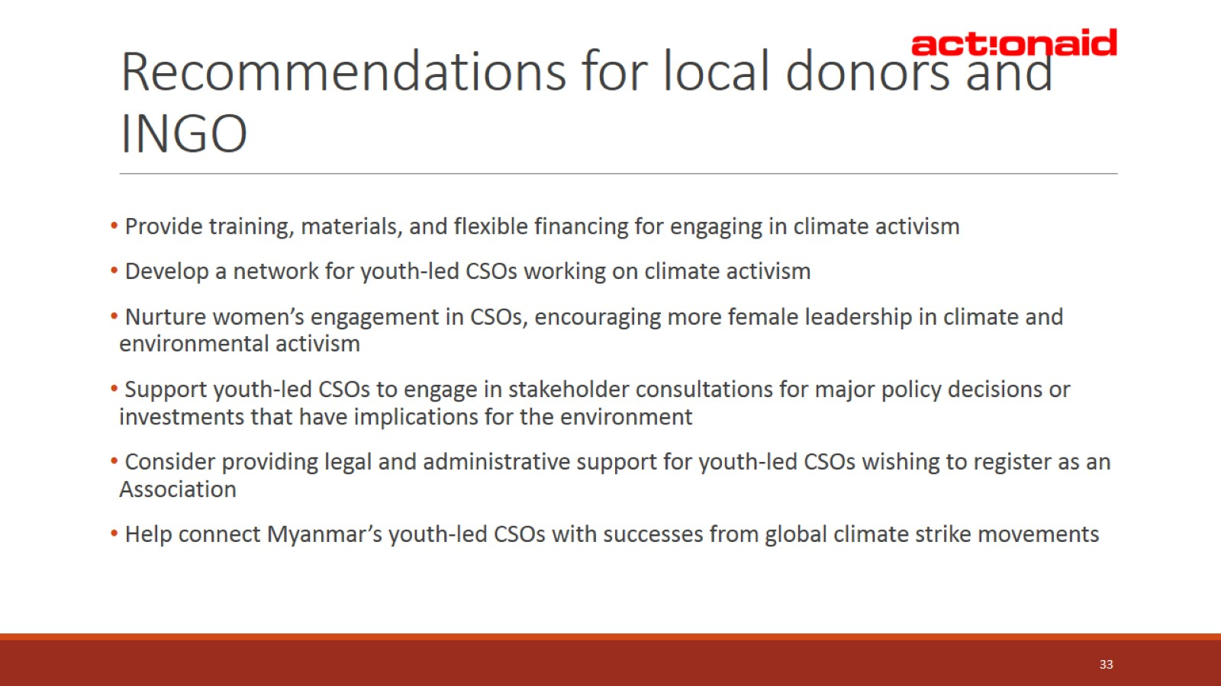
Recommendations for local donors and INGO

Slide 34
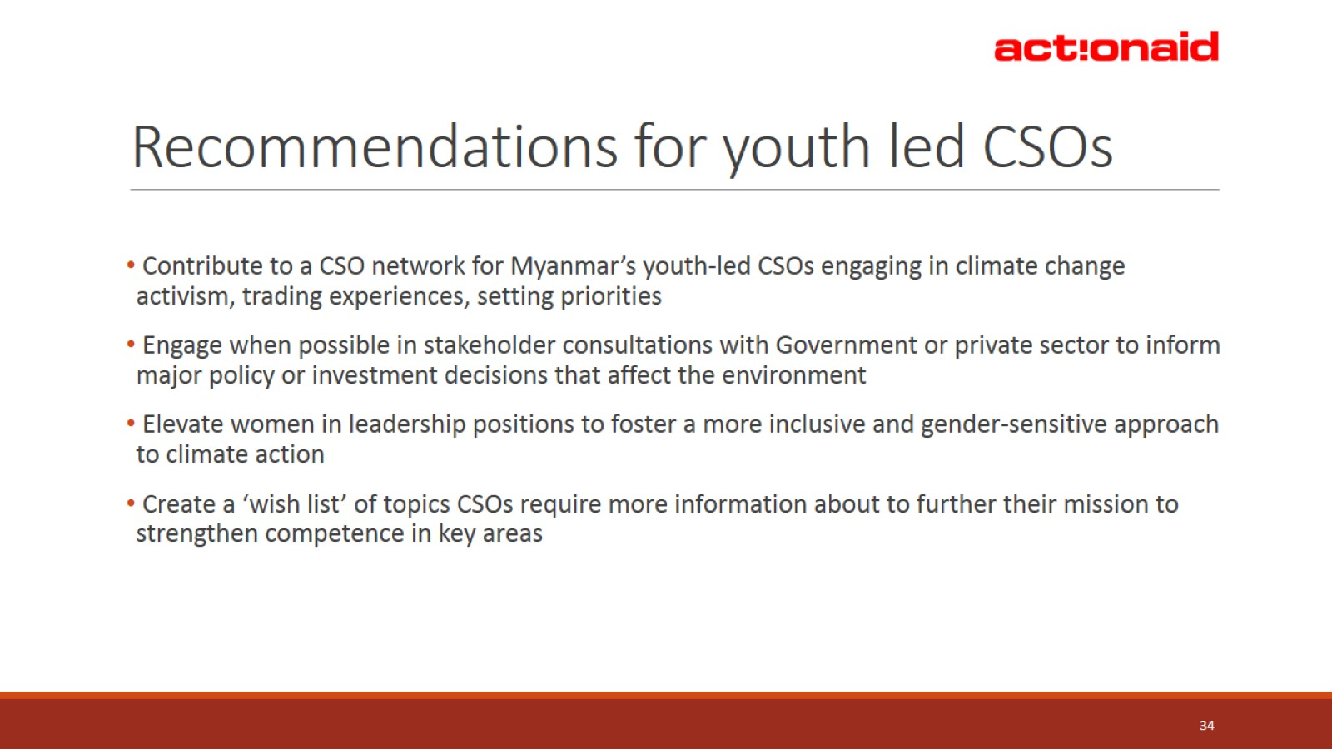
Recommendations for youth led CSOs

Slide 35
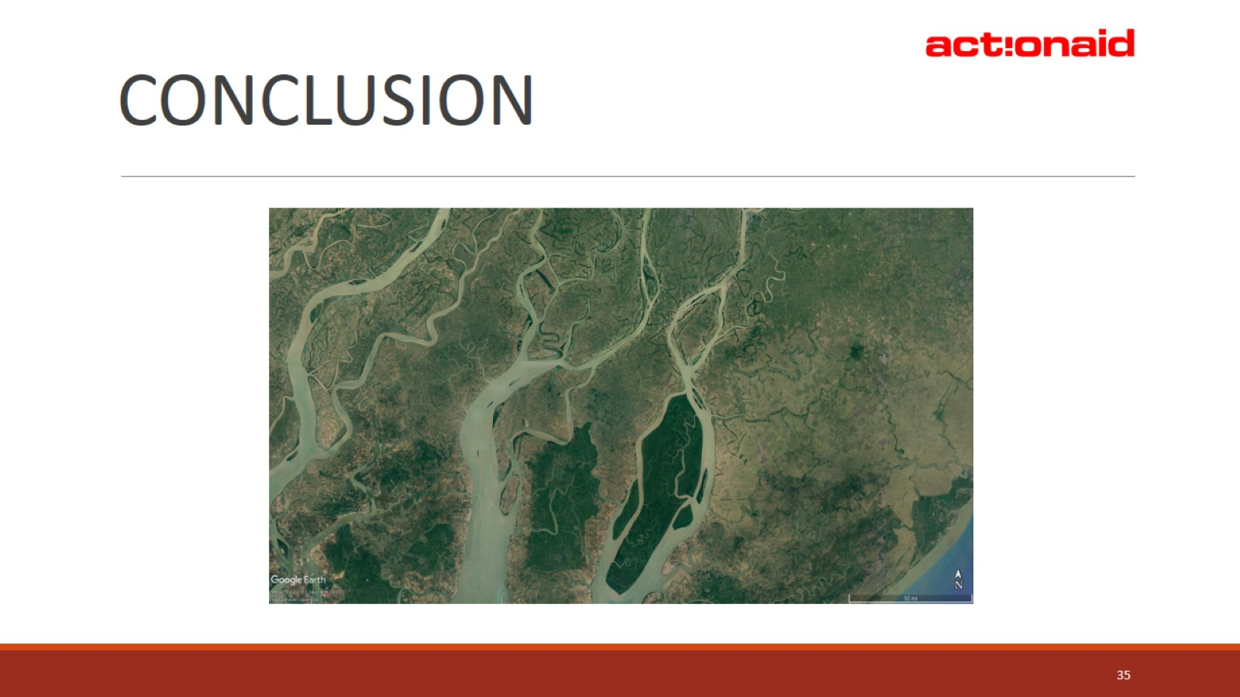

Slide 36
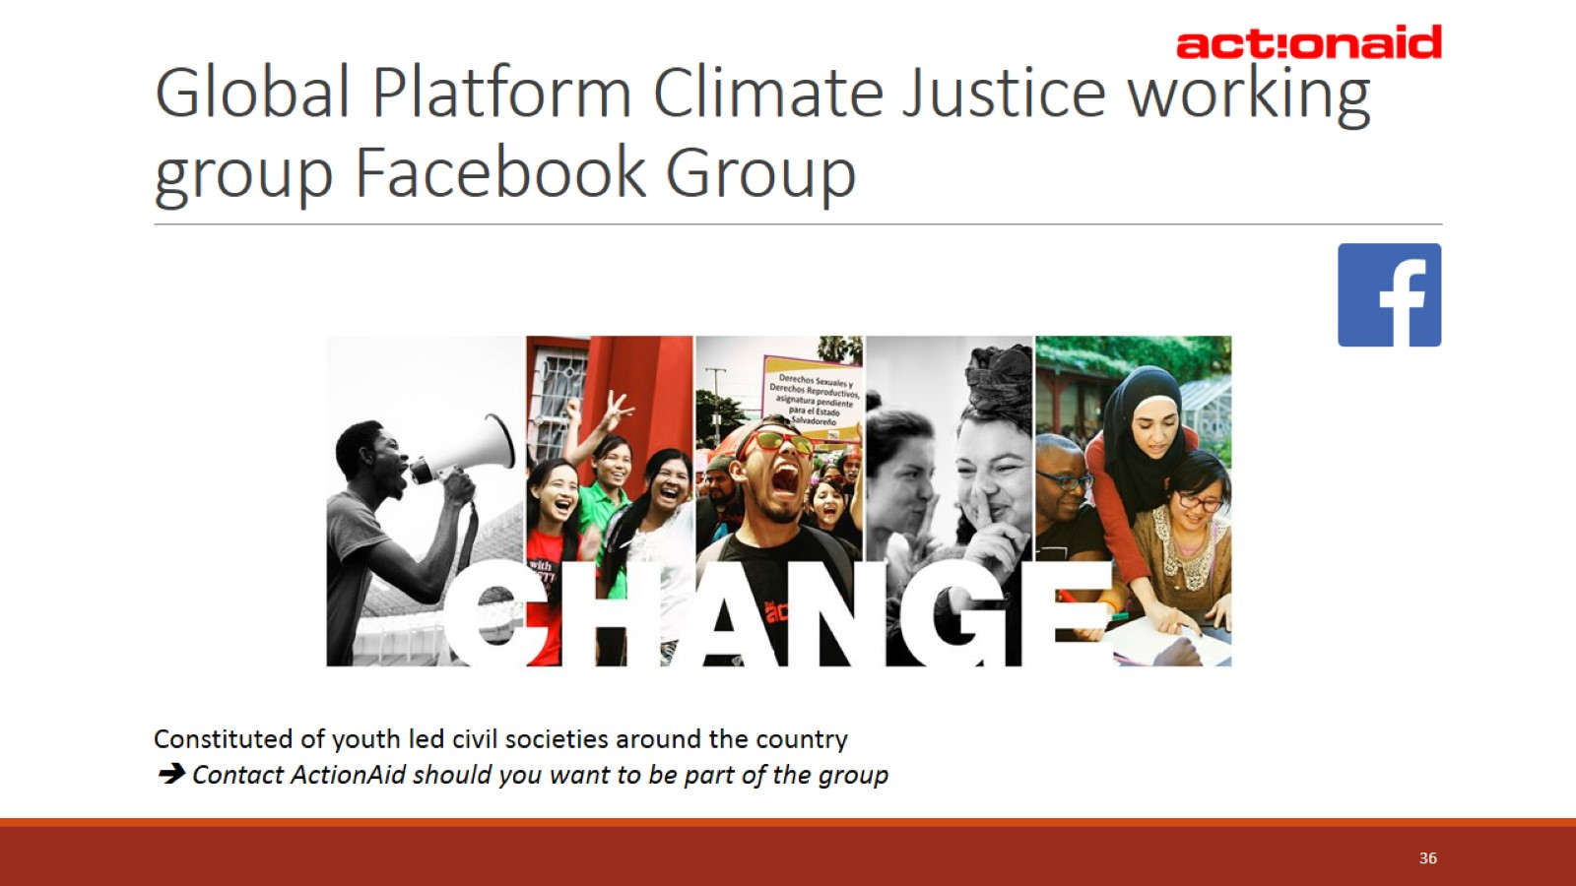
Global Platform Climate Justice working group Facebook Group

